Slide 1
Progress report
Adilet Anuarbekov
SE-2002
EP

Slide 2

NOTATION for PROGRESS
Choosing the Chat WebPage(09.11.2020)
Creating the Basic HTML and CSS carcass for webpage (10.11.2020)
Changing the topic to Construction company DMBS and identifying Aim and Background(11.11.2020)
ERD (12.11.2020)
TABLES SQL (13.11.2020)
Fixing some connections in ERD diagram with FK and PK(16.11.2020)
DDL for changing constraints and datatypes of my database(17.11.2020)
DML statements for filling the tables with values and upgrading them(18.11.2020)
Installing GIT and preparing files for uploading, like the full code of my SQL project(19.11.2020)

Slide 3
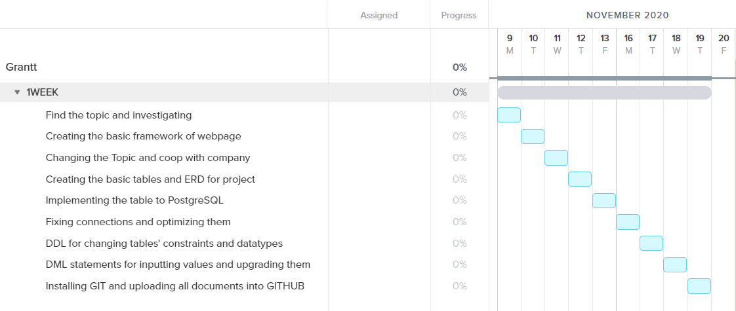
GANTTCHART

Slide 4

AIM
The purpose of the work, is to shorten the work of Secretary or Director, who works with papers, by implementing the DMBS. The new system must include all key data and be capable to edit, manage, delete, and add new data. The system must guide and must have clear and understandable operating principle.
The essence of the project is to make DBMS on POSTGRESQL, in order to make a capable database for further works of company.

Slide 5

Objective of the project:
The main objective of the project, is to make a paperwork of company more reliable and easier. Here is some specific objective which will guide further work:
To create a Database, which would be capable with DDL and DML.
To connect table with each other, to make a full system of tables.
To achieve a normalization of tables, for effectiveness of DBMS.
To create some instruction for further uses of Company.
To make a framework for integrated system for company with their workers, If its needed.

Slide 6

Business rules:
Registered Interns could have only one work to do, which could be repeated among Interns
Interns could be aligned and replaced to Workers’ list.
Every Worker have only one work, which could be repeated among other Workers.
Each worker has their own position among other workers, they could not have such position.
Each employer, who orders a company for building could manage to align many contracts and each contract must be aligned between LLP “AkSatok” and one Employer only.
Each contract must be addressed to only one building
Each building could have only one type and purpose.
In building of every project could be used many types of resources and materials, which could be used in other buildings too
Every type of resource could be supplied by any company, alongside with other resources of that company.

Slide 7
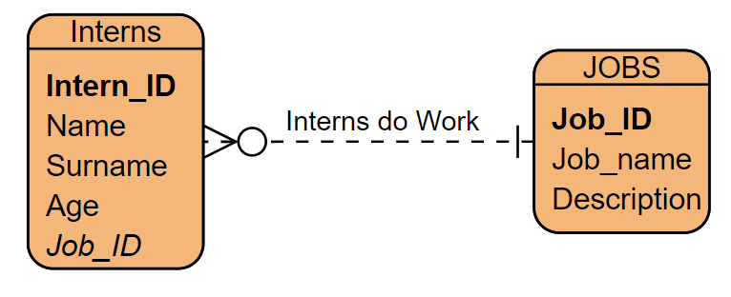
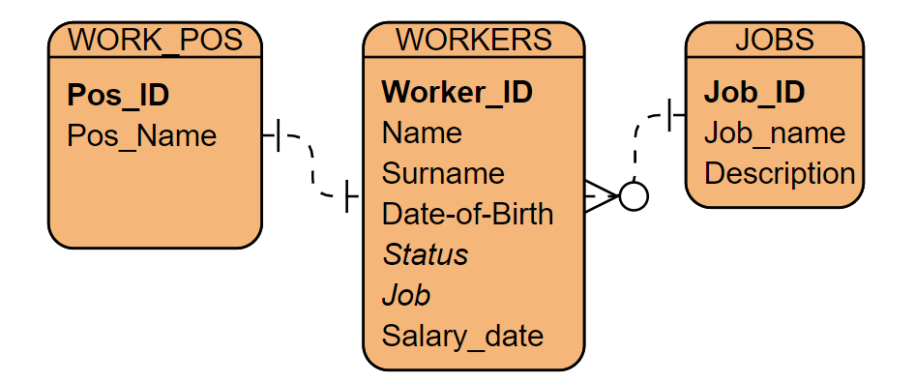
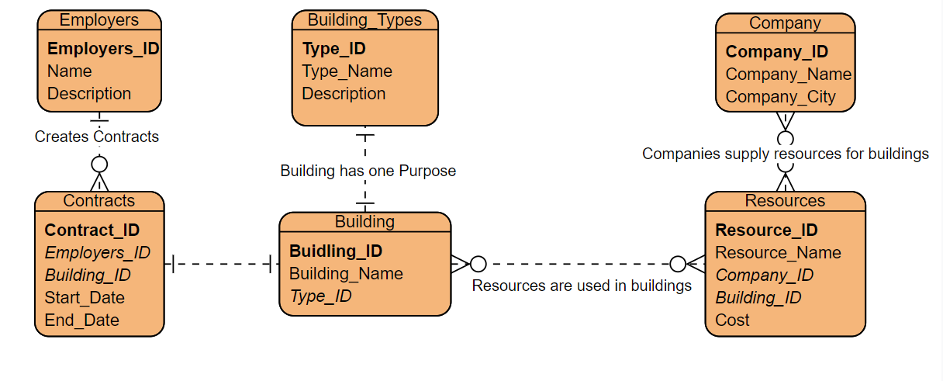

Slide 8
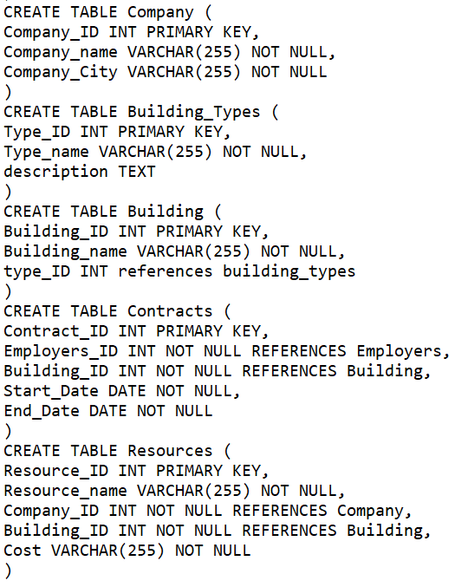
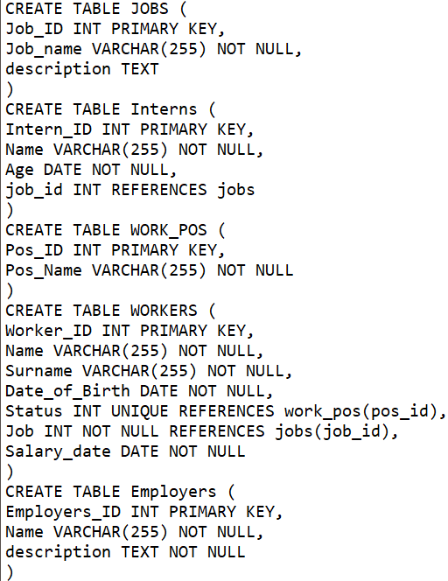
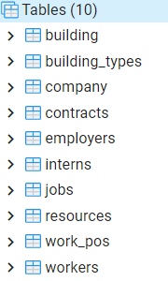
Tables
Tables were implemented in PGADMIN with POSTGRESQL. All 10 entities that were used in ERD, were disposed in this system.

Slide 9
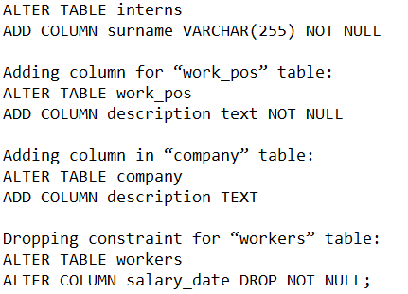
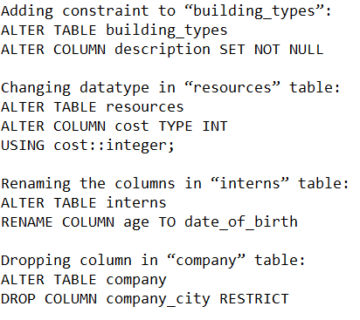
Changing the constraints and datatypes
DDL
Some datatypes of tables were not applicable and usable for DML statements. For example, the date of birth of inters were renamed form age, to “date of birth”, in order to synchronize columns in workers’ and interns’ tables.
Also, the table of resources → column cost were changed from VARCHAR to INT, because the cost could rise and in order to use is, we must use summing, which is not capable with VARCHAR

Slide 10
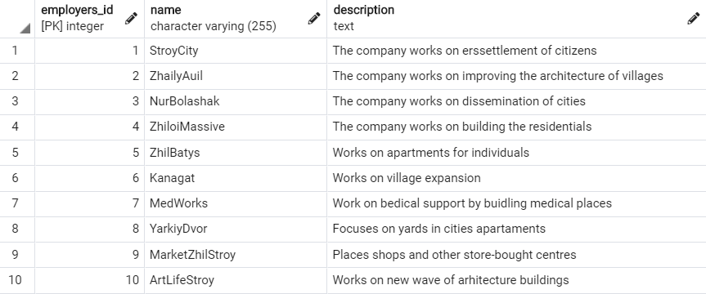
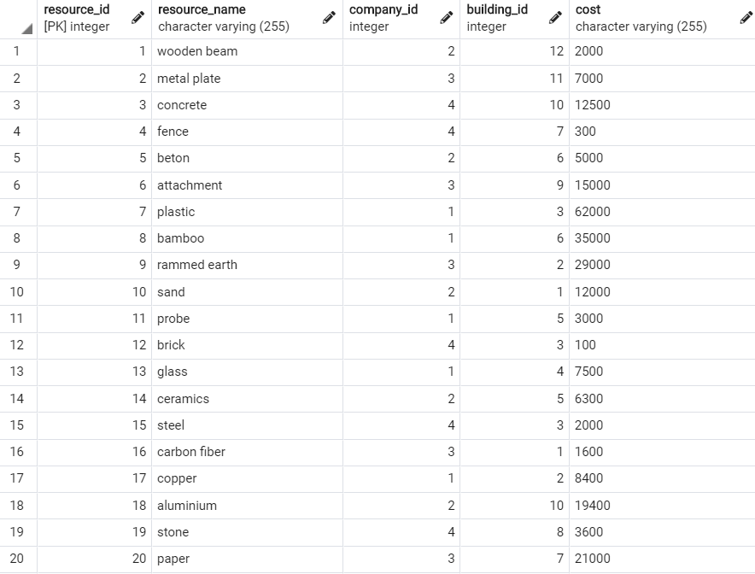
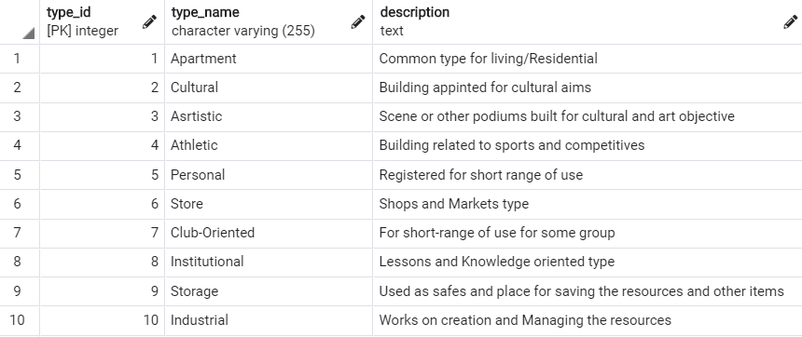
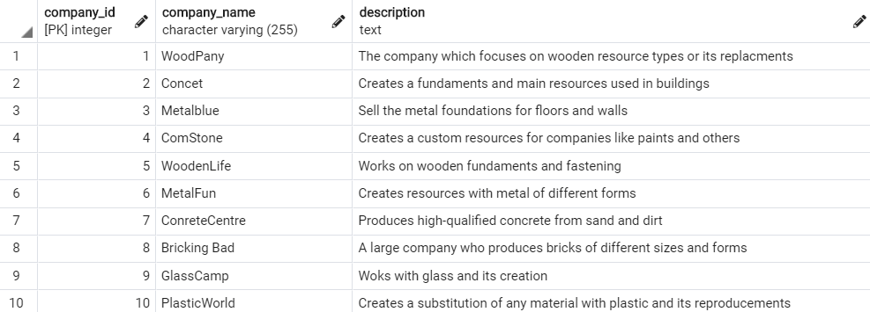
DML: INSERT
I have inserted minimum 10 values for each table, in order to have qualitative values from QUERY statements. Each Value is informative and logically supported for testing the system. Here are some example of full-filled tables.

Slide 11
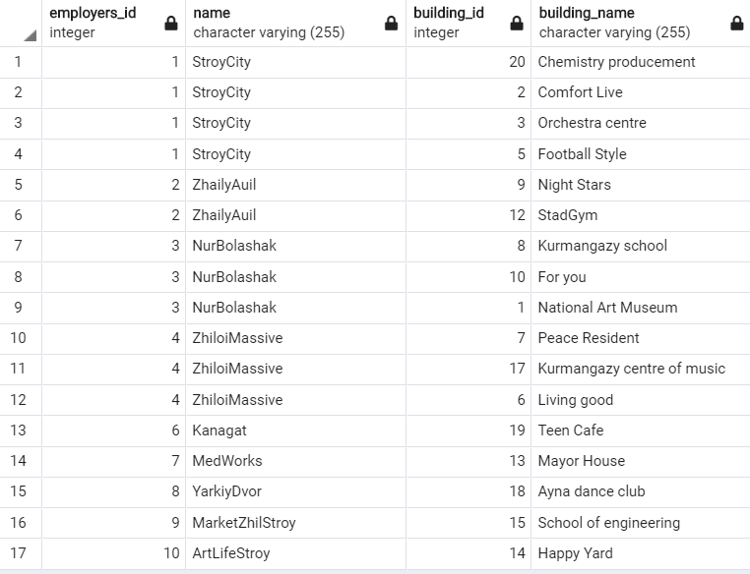
Some QUERIES that could be used:
SELECT employers.employers_id, employers.name, building.building_id, building.building_name
FROM employers
INNER JOIN contracts ON employers.employers_id=contracts.employers_id
INNER JOIN building ON contracts.building_id=building.building_id
ORDER BY employers.employers_id

Slide 12
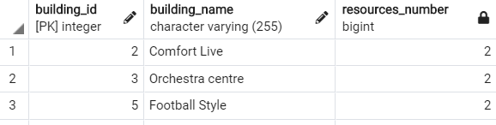
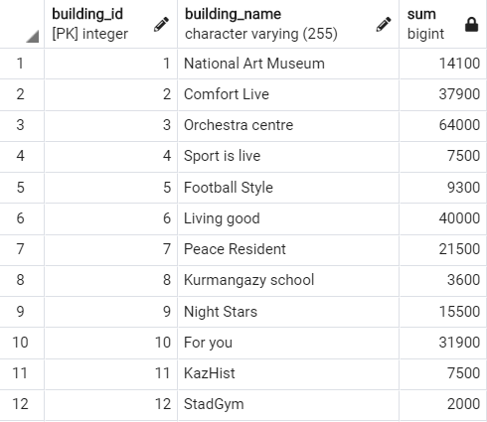
SELECT building.building_id, building.building_name, COUNT(resources.building_id) AS resources_number
FROM employers
INNER JOIN contracts ON employers.employers_id=contracts.employers_id
INNER JOIN building ON contracts.building_id=building.building_id
INNER JOIN resources ON building.building_ID=resources.building_id
WHERE employers.employers_id=1
GROUP BY building.building_id
SELECT building.building_id, building.building_name, SUM(resources.cost)
FROM building
INNER JOIN resources ON building.building_ID=resources.building_id
GROUP BY building.building_id
ORDER BY building.building_id

Slide 13
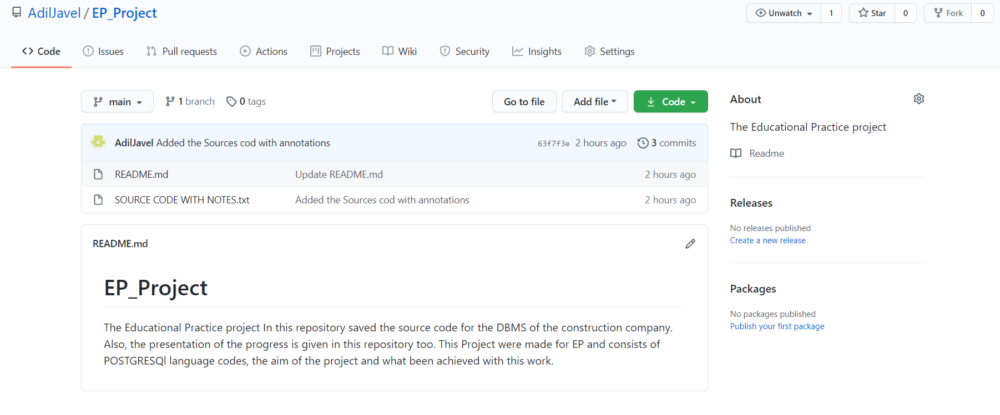
GITHUB
In the GITHUB I have created a README file, which gives general information about the work.
Also, I have uploaded my sources code, were all system-query-language is given, with annotations of its purpose

Slide 14
Conclusion
I have made a DMBS for the construction company, which could be used for saving the data of interns, workers, constructions and all data related to it(employer, resources and short info). The table could be modified and filled with queries and account for fully linked system of tables.
In next slide → all tables that been created with modified changes

Slide 15
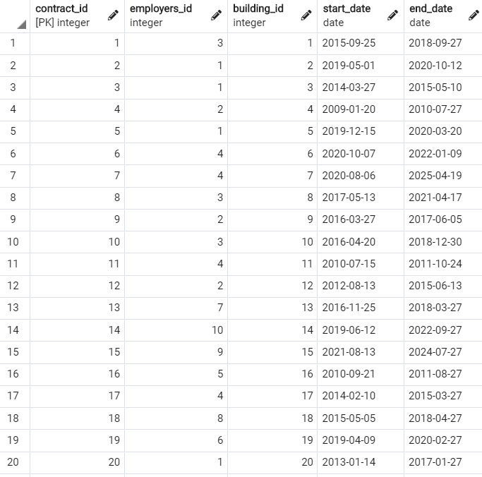

Slide 16
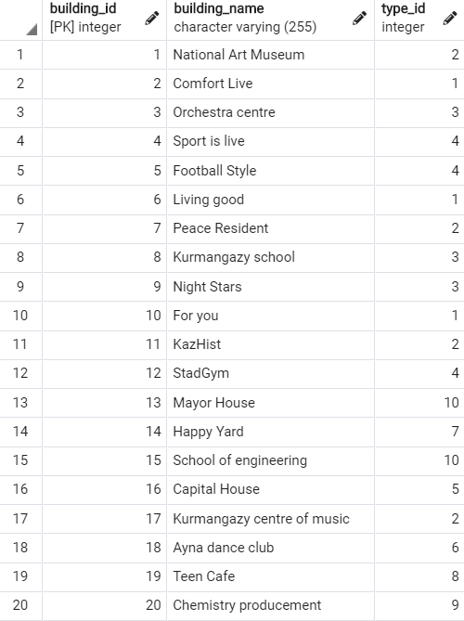
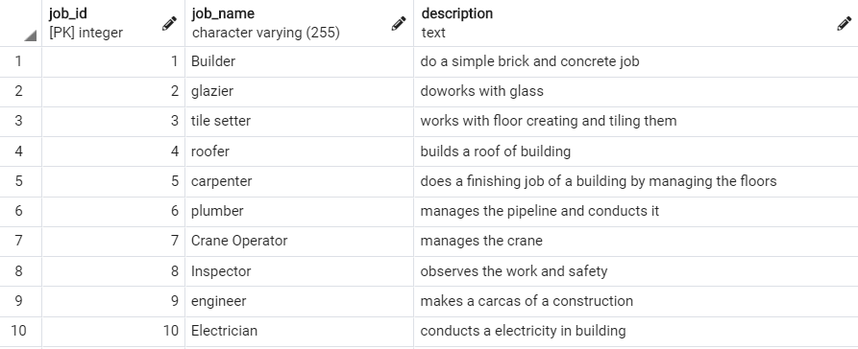
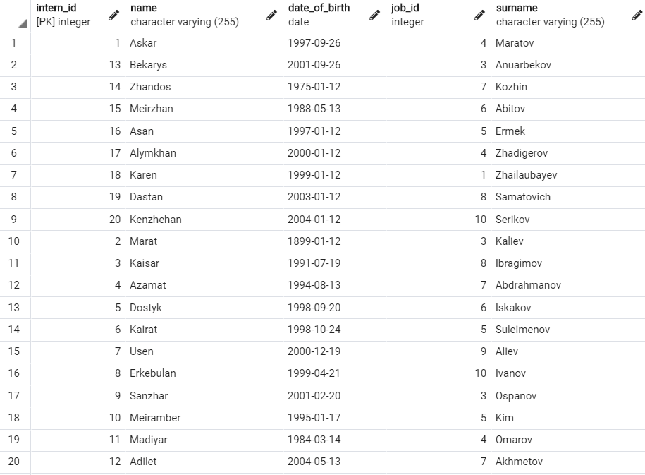
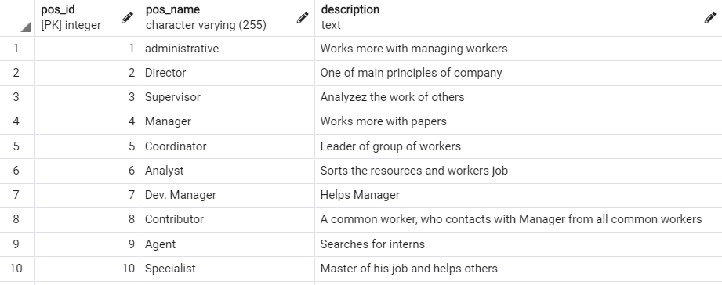

Slide 17
